Slide 1
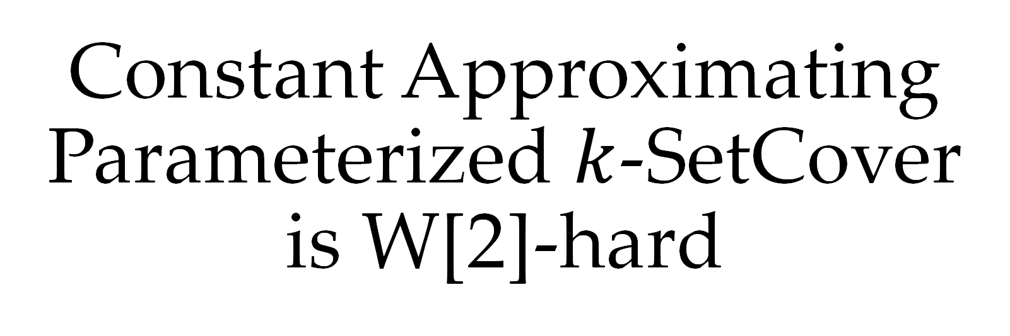
Constant Approximating Parameterized $k$-SetCover is W[2]-hard
Bingkai Lin, Xuandi Ren, Yican Sun, Xiuhan Wang
Jan, 2023
Notes:
Hi everyone! I'm Xuandi Ren from UC Berkeley. Today I'm going to talk about our recent work constant approximating parameterized k-SetCover is W[2]-hard. This is a joint work with Bingkai Lin from Nanjing University, Yican Sun from Peking University, and Xiuhan Wang from Tsinghua University.

Slide 2



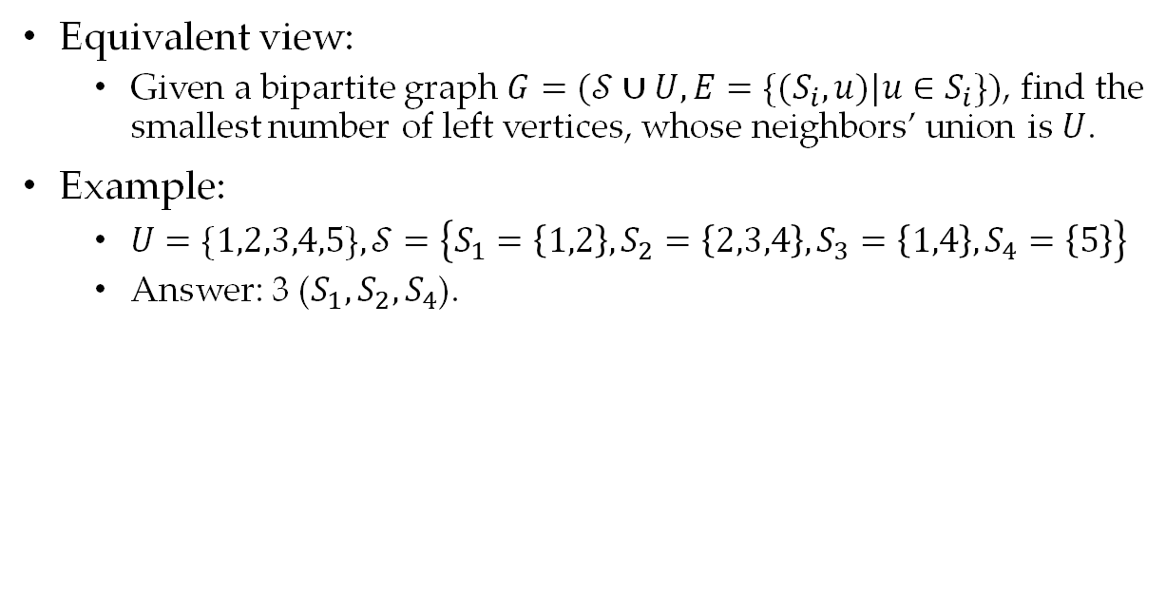

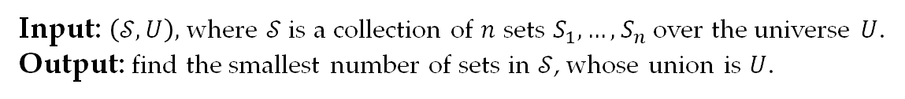




SetCover Problem
1
$$S_{1}$$
Input: $\left(𝒮,U\right),$ where $𝒮$is a collection of $n$ sets $S_{1},…, S_{n}$over the universe $U$.
Output: find the smallest number of sets in $𝒮$, whose union is $U$.
$$2$$
$$S_{2}$$
Equivalent view:
Given a bipartite graph $G=(𝒮∪U,E=\{(S_{i},u)|u∈S_{i}\})$, find the smallest number of left vertices, whose neighbors’ union is $U$.
Example:
$U=\{1,2,3,4,5\},𝒮=\left\{S_{1}=\left\{1,2\right\},S_{2}=\left\{2,3,4\right\},S_{3}=\left\{1,4\right\},S_{4}=\left\{5\right\}\right\}$
Answer: 3 ($S_{1},S_{2},S_{4}$).
$$3$$
$$S_{3}$$
$$4$$
$$S_{4}$$
$$5$$
Notes:
Let me first introduce the SetCover problem. The input is a collection of n sets S1 to Sn over a universe U. The goal is to find the smallest number of sets in S, whose union is U. We can equivalently view an instance as a bipartite graph, where the left side represents sets and the right side represents elements.

Slide 3

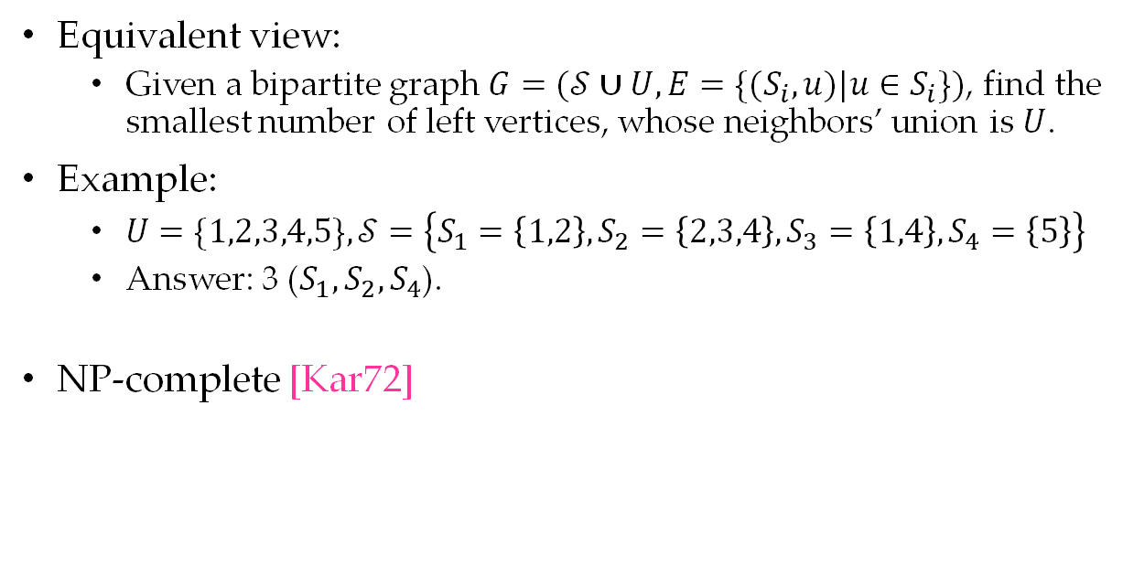



SetCover Problem
1
$$S_{1}$$
Input: $\left(𝒮,U\right),$ where $𝒮$is a collection of $n$ sets $S_{1},…, S_{n}$over the universe $U$.
Output: find the smallest number of sets in $𝒮$, whose union is $U$.
$$2$$
$$S_{2}$$
Equivalent view:
Given a bipartite graph $G=(𝒮∪U,E=\{(S_{i},u)|u∈S_{i}\})$, find the smallest number of left vertices, whose neighbors’ union is $U$.
Example:
$U=\{1,2,3,4,5\},𝒮=\left\{S_{1}=\left\{1,2\right\},S_{2}=\left\{2,3,4\right\},S_{3}=\left\{1,4\right\},S_{4}=\left\{5\right\}\right\}$
Answer: 3 ($S_{1},S_{2},S_{4}$).
NP-complete [Kar72]
$$3$$
$$S_{3}$$
$$4$$
$$S_{4}$$
$$5$$
Notes:
The right figure is an example of 4 sets and 5 elements. The minimum answer is 3 since we can take S1, S2 and S4 to cover the whole universe.
SetCover is one of the first several NP-complete problems as was shown by Karp.

Slide 4

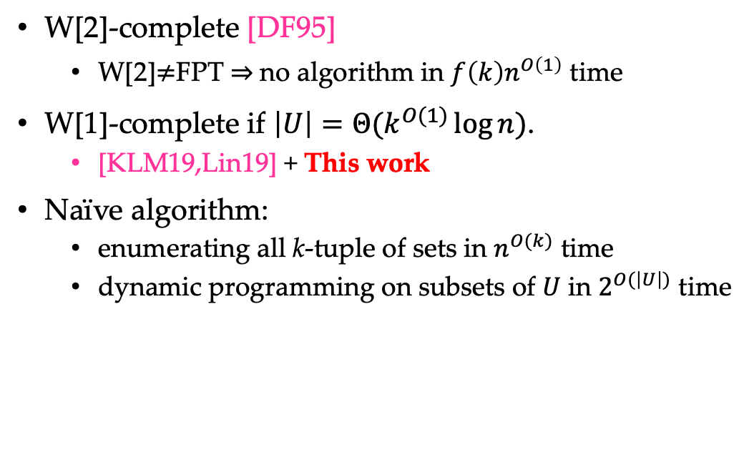
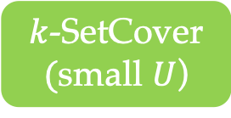


Parameterized SetCover Problem
$k$-SetCover
Input: $\left(𝒮,U,k\right),$ where $𝒮$is a collection of $n$ sets $S_{1},…, S_{n}$over the universe $U$.
Output: find the smallest number of sets in $𝒮$, whose union is $U$. It’s guaranteed that the optimum is $k$.
W[2]-complete [DF95]
W[2]$≠$FPT $⇒$no algorithm in $f\left(k\right)n^{O\left(1\right)}$ time
W[1]-complete if $\left|U\right|=Θ(k^{O(1)}\log{n})$.
[KLM19,Lin19] + This work
Naïve algorithm:
enumerating all k-tuple of sets in $n^{O(k)}$ time
dynamic programming on subsets of $U$ in $2^{O(\left|U\right|)}$ time
W[2]
W[1]
$k$-Clique
$k$-SetCover
$k$-SetCover
$($small $U$)
Notes:
In parameterized SetCover problem, we are additionally given an integer k as parameter which does not grow with n, and it's guaranteed that the optimum is k. We are interested in FPT time algorithms, that is, the running time can be arbitrarily large in terms of k, but should be polynomial in n. k-SetCover problem is the canonical W[2]-complete problem, which means assuming W[2]\neq FPT, it cannot be solved in f(k)poly(n) time for any computable function f. In case that the universe size is as small as poly(k)log n, this problem is a little easier but still W[1]-complete. There are two naive algorithms for this problem: the first is to enumerate all possible k-tuples of sets in n^{O(k)} time. The second is to use dynamic programming and fast subset convolution on subsets of U, in 2^{O(|U|)} time. We can see both algorithms do not run in FPT time even for the restricted case. The right figure shows the relationship between class W[1], W[2], and their respective complete problems.

Slide 5

Approximation of SetCover Problem
“The set cover problem plays the same role in approximation algorithms that the maximum matching problem played in exact algorithms - as a problem whose study led to the development of fundamental techniques for the entire field.”
Approximation Algorithms, by Vijay V. Vazirani
Notes:
as Prof. Vazirani said, SetCover plays a very important role in the study of approximation algorithms and hardness of approximation.

Slide 6
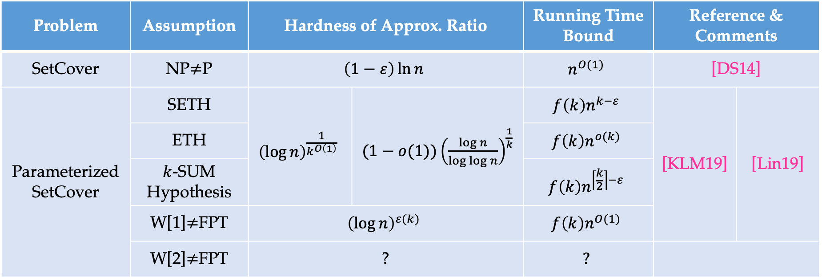
Approximation of SetCover Problem
A simple greedy algorithm reaches $(\ln{n}−\ln{\ln{n}}+Θ(1))$ approximation ratio [Sla97].
Problem | Assumption | Hardness of Approx. Ratio |  | Running Time Bound | Reference & Comments
SetCover | NP$≠$P | $$\left(1−ε\right)\ln{n}$$ |  | $$n^{O(1)}$$ | [DS14]
Parameterized SetCover | SETH | $${\left(\log{n}\right)}^{\frac{1}{k^{O\left(1\right)}}}$$ | $(1−o(1)){\left(\frac{\log{n}}{\log{\log{n}}}\right)}^{\frac{1}{k}}$ | $$f\left(k\right)n^{k−ε}$$ | [KLM19] | [Lin19]
 | ETH |  |  | $$f\left(k\right)n^{o(k)}$$
 | $k$-SUM Hypothesis |  |  | $$f\left(k\right)n^{\left\lceil \frac{k}{2}\right\rceil −ε}$$
 | W[1]$≠$FPT | $${\left(\log{n}\right)}^{ε(k)}$$ |  | $$f\left(k\right)n^{O(1)}$$
 | W[2]$≠$FPT | ? |  | $$?$$
Notes:
Let me briefly list some previous results regarding hardness of approximating SetCover. Note that a simple greedy algorithm can reach ln n-ln ln n+O(1) approximation ratio. Assuming NP\neq P, this cannot be improved to any (1-eps)log n in polynomial time. For parameterized SetCover, we have roughly log n^{1/k} hardness of approximation ratio under different hypothesis and in different running times. However, under W[2]\neq FPT, not even 1.001 ratio FPT hardness was known before. Since k-SetCover is the W[2]-complete problem, people naturally want to base its inapproximability on the hypothesis W[2]\neq FPT.

Slide 7
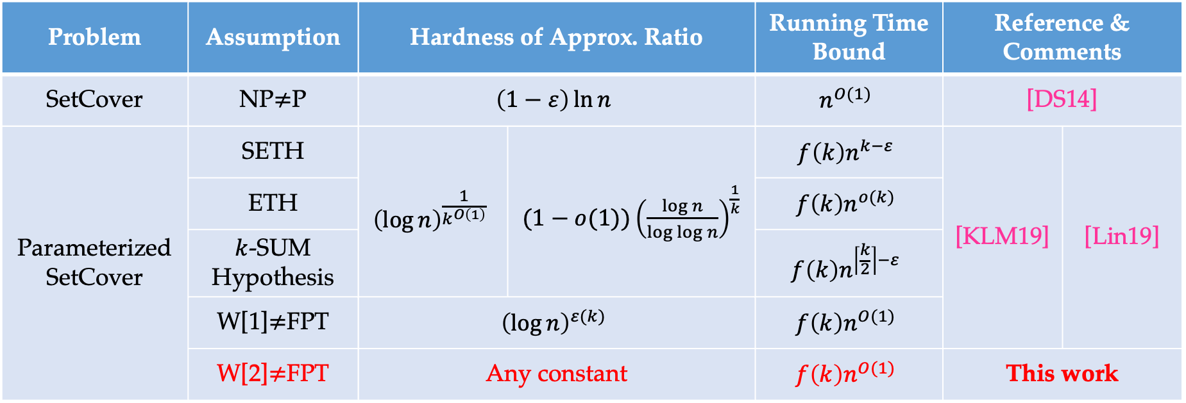
Approximation of SetCover Problem
A simple greedy algorithm reaches $(\ln{n}−\ln{\ln{n}}+Θ(1))$ approximation ratio [Sla97].
Problem | Assumption | Hardness of Approx. Ratio |  | Running Time Bound | Reference & Comments
SetCover | NP$≠$P | $$\left(1−ε\right)\ln{n}$$ |  | $$n^{O(1)}$$ | [DS14]
Parameterized SetCover | SETH | $${\left(\log{n}\right)}^{\frac{1}{k^{O\left(1\right)}}}$$ | $(1−o(1)){\left(\frac{\log{n}}{\log{\log{n}}}\right)}^{\frac{1}{k}}$ | $$f\left(k\right)n^{k−ε}$$ | [KLM19] | [Lin19]
 | ETH |  |  | $$f\left(k\right)n^{o(k)}$$
 | $k$-SUM Hypothesis |  |  | $$f\left(k\right)n^{\left\lceil \frac{k}{2}\right\rceil −ε}$$
 | W[1]$≠$FPT | $${\left(\log{n}\right)}^{ε(k)}$$ |  | $$f\left(k\right)n^{O(1)}$$
 | W[2]$≠$FPT | Any constant |  | $$f\left(k\right)n^{O(1)}$$ | This work
Notes:
In this work, we established the first W[2]-hardness for approximating k-SetCover. We proved that assuming W[2]\neq FPT, no algorithm can compute a constant approximation of k-SetCover in FPT time.

Slide 8

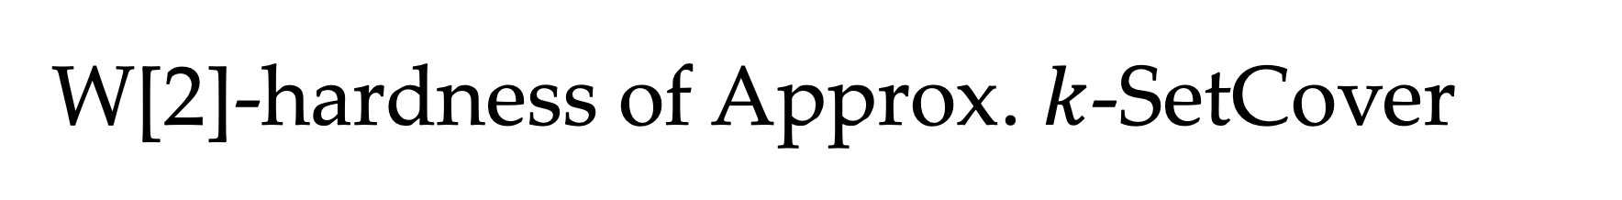




W[2]-hardness of Approx. $k$-SetCover
W[2]
W[2]
W[1]
W[1]
[Lin21,KK22]
$k$-Clique
Gap $k$-Clique
$k$-SetCover
with small $U$
[Lin19]
[KLM19]
$k$-SetCover
Gap $k$-SetCover
This work
Notes:
The following figure shows some similar attempts in reducing complete problems of W[1]/W[2] to gap versions of them. For example, [Lin21],[KarthikKhot22] reduced k-Clique, the W[1]-complete problem, to its gap version, thus proved approximating k-Clique is as hard as computing its exact value. [Lin19] and [KarthikLaekhanukitManurangsi19] reduced k-Clique and k-SetCover with small universe size, two W[1]-complete problems respectively, to gap k-SetCover, and obtained the W[1]-hardness of approximating k-SetCover. In this work, what we do is to reduce k-SetCover with no more restrictions, to the gap version of itself.

Slide 9
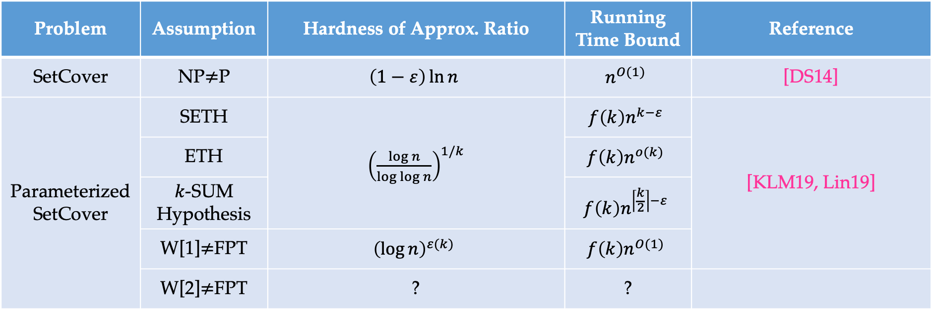
Approximation of SetCover Problem
A simple greedy algorithm reaches $(\ln{n}−\ln{\ln{n}}+Θ(1))$ approximation ratio [Sla97].
Problem | Assumption | Hardness of Approx. Ratio | Running Time Bound | Reference
SetCover | NP$≠$P | $$\left(1−ε\right)\ln{n}$$ | $$n^{O(1)}$$ | [DS14]
Parameterized SetCover | SETH | ${\left(\frac{\log{n}}{\log{\log{n}}}\right)}^{1/k}$ | $$f\left(k\right)n^{k−ε}$$ | [KLM19, Lin19]
 | ETH |  | $$f\left(k\right)n^{o(k)}$$
 | $k$-SUM Hypothesis |  | $$f\left(k\right)n^{\left\lceil \frac{k}{2}\right\rceil −ε}$$
 | W[1]$≠$FPT | $${\left(\log{n}\right)}^{ε(k)}$$ | $$f\left(k\right)n^{O(1)}$$
 | W[2]$≠$FPT | ? | ?
Notes:
Another line of research is that, for non-parameterized SetCover, the optimal solution size may be as large as n, but the inapproximability ratio is log n, the best one. For parameterized k-SetCover, however, the optimal solution size is as small as k, but for the ratio we can only get roughly (log n)^{1/k}. There is a gap between log n and this (log n)^{1/k}. People want to know, whether we can have inapproximability ratio independent of k, while keeping the optimal solution size not growing with n.

Slide 10
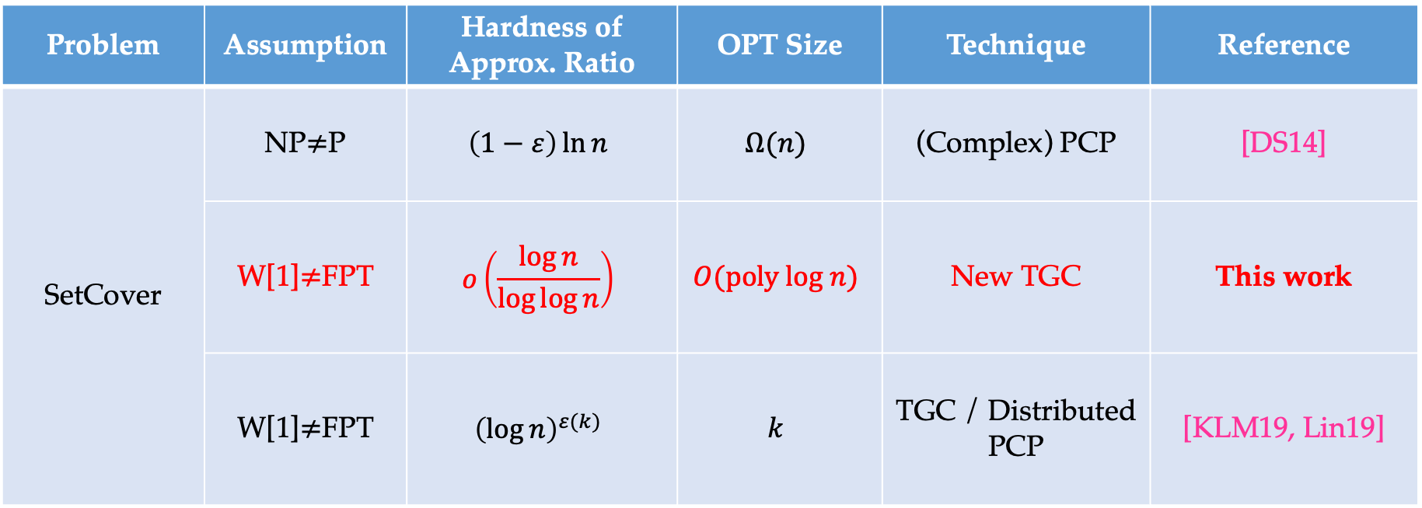
Approx. SetCover with Small OPT Size
Problem | Assumption | Hardness of Approx. Ratio | OPT Size | Technique | Reference
SetCover | NP$≠$P | $$\left(1−ε\right)\ln{n}$$ | $$Ω(n)$$ | (Complex) PCP | [DS14]
 | W[1]$≠$FPT | $$o\left(\frac{\log{n}}{\log{\log{n}}}\right)$$ | $$O(poly log n)$$ | New TGC | This work
 | W[1]$≠$FPT | $${\left(\log{n}\right)}^{ε(k)}$$ | $$k$$ | TGC / Distributed PCP | [KLM19, Lin19]
Notes:
In this work, we reach an intermediate result. We proved the log n/log log n - almost optimal hardness of approximation ratio, while keeping a relatively small optimal solution size - poly log n. This result is based on W[1]\neq FPT and is against polynomial time algorithms. It's worth noting that our technique is fully combinatorial, and does not involve any kind of PCP theorems.

Slide 11


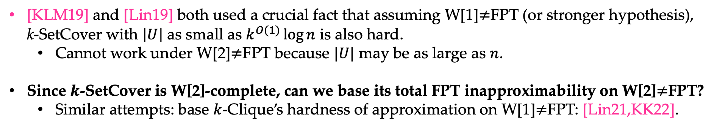



Approximation of SetCover Problem
[KLM19] and [Lin19] both used a crucial fact that assuming W[1]$≠$FPT (or stronger hypothesis), k-SetCover with $\left|U\right|$ as small as $k^{O(1)}\log{n}$ is also hard.
Cannot work under W[2]$≠$FPT because $|U|$ may be as large as $n$.
Since $k$-SetCover is W[2]-complete, can we base its total FPT inapproximability on W[2]$≠$FPT?
Similar attempts: base $k$-Clique’s hardness of approximation on W[1]$≠$FPT: [Lin21,KK22].
W[2]
W[1]
[Lin21,KK22]
Gap $k$-Clique
$k$-Clique
[KLM19]
$k$-SetCover
Gap $k$-SetCover
$k$-SetCover
with small $U$
[Lin19]
This work

Slide 12


Our Technique
Threshold Graph Composition [Lin18, CL19, Lin19, BBE+21]
exploited new properties of threshold graphs
used the construction from error-correcting codes [KN21]
discovered new composition scheme
Constant Approximating k-SetCover is W[2]-hard!
k-SetCover Instance
Threshold Graphs
$$=$$
Constant Gap k’-SetCover Instance
$$+$$
Notes:
Our technique is threshold graph composition, which has been used to prove many FPT hardness of approximation results. Specifically, we exploited new properties of threshold graphs, used new constructions, and applied a new composition scheme. Given a k-SetCover instance, we build a threshold graph using error-correcting codes, then combine both of them to get a constant gap k'-SetCover instance.

Slide 13

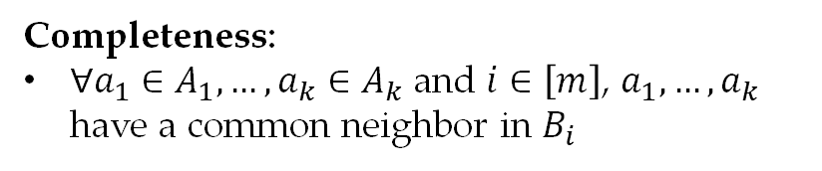









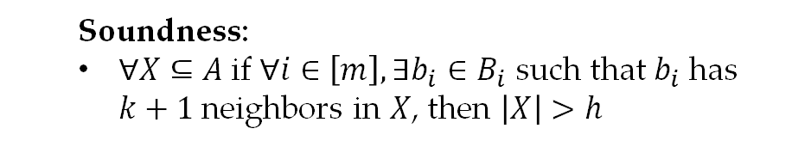
Threshold Graph in [Lin19]
Threshold Graph $G_{T}$: a bipartite graph $(A∪B,E)$ with $A=A_{1}∪…∪A_{k}$ and $B=B_{1}∪…∪B_{m}$, satisfying
$$B_{1}$$
Completeness:
$∀a_{1}∈A_{1},…,a_{k}∈A_{k}$ and $i∈\left[m\right]$, $a_{1},…,a_{k}$ have a common neighbor in $B_{i}$
$$A_{1}$$
$$B_{2}$$
$$A_{2}$$
Soundness:
$∀X⊆A$if $∀i∈\left[m\right],∃b_{i}∈B_{i}$ such that $b_{i}$ has $k+1$ neighbors in $X$, then $\left|X\right|>h$
$$B_{3}$$
$$…$$
$$…$$
$$A_{k}$$
$$B_{m}$$
Notes:
Now let me give a review on the construction of threshold graph in [Lin19]. It is a bipartite graph where the left side is divided into k parts and the right side is divided into m parts.

Slide 14
Threshold Graph in [Lin19]
Threshold Graph $G_{T}$: a bipartite graph $(A∪B,E)$ with $A=A_{1}∪…∪A_{k}$ and $B=B_{1}∪…∪B_{m}$, satisfying
$$B_{1}$$
Completeness:
$∀a_{1}∈A_{1},…,a_{k}∈A_{k}$ and $i∈\left[m\right]$, $a_{1},…,a_{k}$ have a common neighbor in $B_{i}$
$$A_{1}$$
$$B_{2}$$
$$A_{2}$$
Soundness:
$∀X⊆A$if $∀i∈\left[m\right],∃b_{i}∈B_{i}$ such that $b_{i}$ has $k+1$ neighbors in $X$, then $\left|X\right|>h$
$$B_{3}$$
$$…$$
$$…$$
$$A_{k}$$
$$B_{m}$$
Notes:
The completeness property says that, no matter how we pick a vertex from each of the left parts, they have a common neighbor in each of the right parts.

Slide 15
Threshold Graph in [Lin19]
Threshold Graph $G_{T}$: a bipartite graph $(A∪B,E)$ with $A=A_{1}∪…∪A_{k}$ and $B=B_{1}∪…∪B_{m}$, satisfying
$$B_{1}$$
Completeness:
$∀a_{1}∈A_{1},…,a_{k}∈A_{k}$ and $i∈\left[m\right]$, $a_{1},…,a_{k}$ have a common neighbor in $B_{i}$
$$A_{1}$$
$$B_{2}$$
$$A_{2}$$
Soundness:
$∀X⊆A$if $∀i∈\left[m\right],∃b_{i}∈B_{i}$ such that $b_{i}$ has $k+1$ neighbors in $X$, then $\left|X\right|>h$
$$B_{3}$$
$$…$$
$$…$$
$$A_{k}$$
$$B_{m}$$
Notes:
The completeness property says that, no matter how we pick a vertex from each of the left parts, they have a common neighbor in each of the right parts.

Slide 16
Threshold Graph in [Lin19]
Threshold Graph $G_{T}$: a bipartite graph $(A∪B,E)$ with $A=A_{1}∪…∪A_{k}$ and $B=B_{1}∪…∪B_{m}$, satisfying
$$B_{1}$$
Completeness:
$∀a_{1}∈A_{1},…,a_{k}∈A_{k}$ and $i∈\left[m\right]$, $a_{1},…,a_{k}$ have a common neighbor in $B_{i}$
$$A_{1}$$
$$B_{2}$$
$$A_{2}$$
Soundness:
$∀X⊆A$if $∀i∈\left[m\right],∃b_{i}∈B_{i}$ such that $b_{i}$ has $k+1$ neighbors in $X$, then $\left|X\right|>h$
$$B_{3}$$
$$…$$
$$…$$
$$A_{k}$$
$$B_{m}$$
Notes:
The completeness property says that, no matter how we pick a vertex from each of the left parts, they have a common neighbor in each of the right parts.

Slide 17
Threshold Graph in [Lin19]
Threshold Graph $G_{T}$: a bipartite graph $(A∪B,E)$ with $A=A_{1}∪…∪A_{k}$ and $B=B_{1}∪…∪B_{m}$, satisfying
$$B_{1}$$
Completeness:
$∀a_{1}∈A_{1},…,a_{k}∈A_{k}$ and $i∈\left[m\right]$, $a_{1},…,a_{k}$ have a common neighbor in $B_{i}$
$$A_{1}$$
$$B_{2}$$
$$A_{2}$$
Soundness:
$∀X⊆A$if $∀i∈\left[m\right],∃b_{i}∈B_{i}$ such that $b_{i}$ has $k+1$ neighbors in $X$, then $\left|X\right|>h$
$$B_{3}$$
$$…$$
$$…$$
$$A_{k}$$
$$B_{m}$$
Notes:
The completeness property says that, no matter how we pick a vertex from each of the left parts, they have a common neighbor in each of the right parts.

Slide 18

Threshold Graph in [Lin19]
Threshold Graph $G_{T}$: a bipartite graph $(A∪B,E)$ with $A=A_{1}∪…∪A_{k}$ and $B=B_{1}∪…∪B_{m}$, satisfying
$$B_{1}$$
Completeness:
$∀a_{1}∈A_{1},…,a_{k}∈A_{k}$ and $i∈\left[m\right]$, $a_{1},…,a_{k}$ have a common neighbor in $B_{i}$
$$A_{1}$$
$$≥k+1$$
$$B_{2}$$
$$A_{2}$$
Soundness:
$∀X⊆A$if $∀i∈\left[m\right],∃b_{i}∈B_{i}$ such that $b_{i}$ has $k+1$ neighbors in $X$, then $\left|X\right|>h$
$$B_{3}$$
$$…$$
$$…$$
$$A_{k}$$
$$B_{m}$$
Notes:
The soundness property says that, suppose we have a subset of left vertices as painted in red here, such that in each right part, there exists a vertex which has at least k+1 neighbors in them, then we can deduce the number of such red vertices is greater than h.

Slide 19
Threshold Graph in [Lin19]
Threshold Graph $G_{T}$: a bipartite graph $(A∪B,E)$ with $A=A_{1}∪…∪A_{k}$ and $B=B_{1}∪…∪B_{m}$, satisfying
$$B_{1}$$
Completeness:
$∀a_{1}∈A_{1},…,a_{k}∈A_{k}$ and $i∈\left[m\right]$, $a_{1},…,a_{k}$ have a common neighbor in $B_{i}$
$$A_{1}$$
$$B_{2}$$
$$A_{2}$$
$$≥k+1$$
Soundness:
$∀X⊆A$if $∀i∈\left[m\right],∃b_{i}∈B_{i}$ such that $b_{i}$ has $k+1$ neighbors in $X$, then $\left|X\right|>h$
$$B_{3}$$
$$…$$
$$…$$
$$A_{k}$$
$$B_{m}$$
Notes:
The soundness property says that, suppose we have a subset of left vertices as painted in red here, such that in each right part, there exists a vertex which has at least k+1 neighbors in them, then we can deduce the number of such red vertices is greater than h.

Slide 20

Threshold Graph in [Lin19]
Threshold Graph $G_{T}$: a bipartite graph $(A∪B,E)$ with $A=A_{1}∪…∪A_{k}$ and $B=B_{1}∪…∪B_{m}$, satisfying
$$B_{1}$$
Completeness:
$∀a_{1}∈A_{1},…,a_{k}∈A_{k}$ and $i∈\left[m\right]$, $a_{1},…,a_{k}$ have a common neighbor in $B_{i}$
$$A_{1}$$
$$B_{2}$$
$$A_{2}$$
Soundness:
$∀X⊆A$if $∀i∈\left[m\right],∃b_{i}∈B_{i}$ such that $b_{i}$ has $k+1$ neighbors in $X$, then $\left|X\right|>h$
$$≥k+1$$
$$B_{3}$$
$$…$$
$$…$$
$$A_{k}$$
$$B_{m}$$
Notes:
The soundness property says that, suppose we have a subset of left vertices as painted in red here, such that in each right part, there exists a vertex which has at least k+1 neighbors in them, then we can deduce the number of such red vertices is greater than h.

Slide 21
Threshold Graph in [Lin19]
Threshold Graph $G_{T}$: a bipartite graph $(A∪B,E)$ with $A=A_{1}∪…∪A_{k}$ and $B=B_{1}∪…∪B_{m}$, satisfying
$$B_{1}$$
Completeness:
$∀a_{1}∈A_{1},…,a_{k}∈A_{k}$ and $i∈\left[m\right]$, $a_{1},…,a_{k}$ have a common neighbor in $B_{i}$
$$A_{1}$$
$$B_{2}$$
$$A_{2}$$
Soundness:
$∀X⊆A$if $∀i∈\left[m\right],∃b_{i}∈B_{i}$ such that $b_{i}$ has $k+1$ neighbors in $X$, then $\left|X\right|>h$
$$B_{3}$$
$$…$$
$$…$$
$$A_{k}$$
$$≥k+1$$
$$B_{m}$$
Notes:
The soundness property says that, suppose we have a subset of left vertices as painted in red here, such that in each right part, there exists a vertex which has at least k+1 neighbors in them, then we can deduce the number of such red vertices is greater than h.

Slide 22


Threshold Graph in [Lin19]
Threshold Graph $G_{T}$: a bipartite graph $(A∪B,E)$ with $A=A_{1}∪…∪A_{k}$ and $B=B_{1}∪…∪B_{m}$, satisfying
$$B_{1}$$
Completeness:
$∀a_{1}∈A_{1},…,a_{k}∈A_{k}$ and $i∈\left[m\right]$, $a_{1},…,a_{k}$ have a common neighbor in $B_{i}$
$$A_{1}$$
$$B_{2}$$
$$A_{2}$$
Soundness:
$∀X⊆A$if $∀i∈\left[m\right],∃b_{i}∈B_{i}$ such that $b_{i}$ has $k+1$ neighbors in $X$, then $\left|X\right|>h$
$$B_{3}$$
$$…$$
$$…$$
$$A_{k}$$
$$B_{m}$$
$$⇒$$
$\#$ of $>h$
Notes:
The soundness property says that, suppose we have a subset of left vertices as painted in red here, such that in each right part, there exists a vertex which has at least k+1 neighbors in them, then we can deduce the number of such red vertices is greater than h.

Slide 23
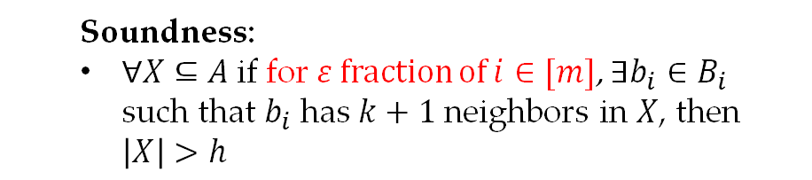
Our Threshold Graph
Threshold Graph $G_{T}$: a bipartite graph $(A∪B,E)$ with $A=A_{1}∪…∪A_{k}$ and $B=B_{1}∪…∪B_{m}$, satisfying
$$B_{1}$$
Completeness:
$∀a_{1}∈A_{1},…,a_{k}∈A_{k}$ and $i∈\left[m\right]$, $a_{1},…,a_{k}$ have a common neighbor in $B_{i}$
$$A_{1}$$
$$B_{2}$$
$$A_{2}$$
Soundness:
$∀X⊆A$if for $ε$ fraction of $i∈[m]$, $∃b_{i}∈B_{i}$ such that $b_{i}$ has $k+1$ neighbors in $X$, then $\left|X\right|>h$
$$B_{3}$$
$$…$$
$$…$$
$$A_{k}$$
$$B_{m}$$
Notes:
In our construction, we slightly modify the soundness statement. As long as there are eps fraction of right parts, in which there exist vertices with k+1 neighbors, we can deduce a lower bound on the number of red vertices. This lower bound may be inferior to the previous one, but is still enough for our use. Such threshold graphs can be constructed via error-correcting codes with good distance.

Slide 24
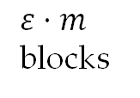
Our Threshold Graph
Threshold Graph $G_{T}$: a bipartite graph $(A∪B,E)$ with $A=A_{1}∪…∪A_{k}$ and $B=B_{1}∪…∪B_{m}$, satisfying
$$B_{1}$$
Completeness:
$∀a_{1}∈A_{1},…,a_{k}∈A_{k}$ and $i∈\left[m\right]$, $a_{1},…,a_{k}$ have a common neighbor in $B_{i}$
$$A_{1}$$
$$≥k+1$$
$$B_{2}$$
$$A_{2}$$
$ε⋅m$ blocks
Soundness:
$∀X⊆A$if for $ε$ fraction of $i∈[m]$, $∃b_{i}∈B_{i}$ such that $b_{i}$ has $k+1$ neighbors in $X$, then $\left|X\right|>h$
$$B_{3}$$
$$…$$
$$…$$
$$A_{k}$$
$$B_{m}$$
Notes:
In our construction, we slightly modify the soundness statement. As long as there are eps fraction of right parts, in which there exist vertices with k+1 neighbors, we can deduce a lower bound on the number of red vertices. This lower bound may be inferior to the previous one, but is still enough for our use. Such threshold graphs can be constructed via error-correcting codes with good distance.

Slide 25
Our Threshold Graph
Threshold Graph $G_{T}$: a bipartite graph $(A∪B,E)$ with $A=A_{1}∪…∪A_{k}$ and $B=B_{1}∪…∪B_{m}$, satisfying
$$B_{1}$$
Completeness:
$∀a_{1}∈A_{1},…,a_{k}∈A_{k}$ and $i∈\left[m\right]$, $a_{1},…,a_{k}$ have a common neighbor in $B_{i}$
$$A_{1}$$
$$B_{2}$$
$$A_{2}$$
$$≥k+1$$
$ε⋅m$ blocks
Soundness:
$∀X⊆A$if for $ε$ fraction of $i∈[m]$, $∃b_{i}∈B_{i}$ such that $b_{i}$ has $k+1$ neighbors in $X$, then $\left|X\right|>h$
$$B_{3}$$
$$…$$
$$…$$
$$A_{k}$$
$$B_{m}$$
Notes:
In our construction, we slightly modify the soundness statement. As long as there are eps fraction of right parts, in which there exist vertices with k+1 neighbors, we can deduce a lower bound on the number of red vertices. This lower bound may be inferior to the previous one, but is still enough for our use. Such threshold graphs can be constructed via error-correcting codes with good distance.

Slide 26
Our Threshold Graph
Threshold Graph $G_{T}$: a bipartite graph $(A∪B,E)$ with $A=A_{1}∪…∪A_{k}$ and $B=B_{1}∪…∪B_{m}$, satisfying
$$B_{1}$$
Completeness:
$∀a_{1}∈A_{1},…,a_{k}∈A_{k}$ and $i∈\left[m\right]$, $a_{1},…,a_{k}$ have a common neighbor in $B_{i}$
$$A_{1}$$
$$B_{2}$$
$$A_{2}$$
$ε⋅m$ blocks
Soundness:
$∀X⊆A$if for $ε$ fraction of $i∈[m]$, $∃b_{i}∈B_{i}$ such that $b_{i}$ has $k+1$ neighbors in $X$, then $\left|X\right|>h$
$$≥k+1$$
$$B_{3}$$
$$…$$
$$…$$
$$A_{k}$$
$$B_{m}$$
Notes:
In our construction, we slightly modify the soundness statement. As long as there are eps fraction of right parts, in which there exist vertices with k+1 neighbors, we can deduce a lower bound on the number of red vertices. This lower bound may be inferior to the previous one, but is still enough for our use. Such threshold graphs can be constructed via error-correcting codes with good distance.

Slide 27
Our Threshold Graph
Threshold Graph $G_{T}$: a bipartite graph $(A∪B,E)$ with $A=A_{1}∪…∪A_{k}$ and $B=B_{1}∪…∪B_{m}$, satisfying
$$B_{1}$$
Completeness:
$∀a_{1}∈A_{1},…,a_{k}∈A_{k}$ and $i∈\left[m\right]$, $a_{1},…,a_{k}$ have a common neighbor in $B_{i}$
$$A_{1}$$
$$B_{2}$$
$$A_{2}$$
$ε⋅m$ blocks
Soundness:
$∀X⊆A$if for $ε$ fraction of $i∈[m]$, $∃b_{i}∈B_{i}$ such that $b_{i}$ has $k+1$ neighbors in $X$, then $\left|X\right|>h$
$$B_{3}$$
$$…$$
$$…$$
$$A_{k}$$
$$B_{m}$$
$$⇒$$
$\#$ of $>h$
Notes:
In our construction, we slightly modify the soundness statement. As long as there are eps fraction of right parts, in which there exist vertices with k+1 neighbors, we can deduce a lower bound on the number of red vertices. This lower bound may be inferior to the previous one, but is still enough for our use. Such threshold graphs can be constructed via error-correcting codes with good distance.

Slide 28
Our Threshold Graph
Threshold Graph $G_{T}$: a bipartite graph $(A∪B,E)$ with $A=A_{1}∪…∪A_{k}$ and $B=B_{1}∪…∪B_{m}$, satisfying
$$B_{1}$$
Completeness:
$∀a_{1}∈A_{1},…,a_{k}∈A_{k}$ and $i∈\left[m\right]$, $a_{1},…,a_{k}$ have a common neighbor in $B_{i}$
$$A_{1}$$
$$B_{2}$$
$$A_{2}$$
$ε⋅m$ blocks
Soundness:
$∀X⊆A$if for $ε$ fraction of $i∈[m]$, $∃b_{i}∈B_{i}$ such that $b_{i}$ has $k+1$ neighbors in $X$, then $\left|X\right|>h$
$$B_{3}$$
$$…$$
$$…$$
$$A_{k}$$
$$B_{m}$$
Such threshold graphs can be constructed via error correcting codes with benign distance [KN21]!
$$⇒$$
$\#$ of $>h$
Notes:
In our construction, we slightly modify the soundness statement. As long as there are eps fraction of right parts, in which there exist vertices with k+1 neighbors, we can deduce a lower bound on the number of red vertices. This lower bound may be inferior to the previous one, but is still enough for our use. Such threshold graphs can be constructed via error-correcting codes with good distance.

Slide 29

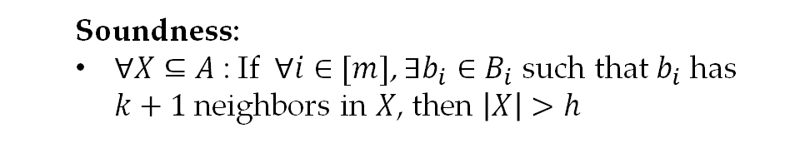
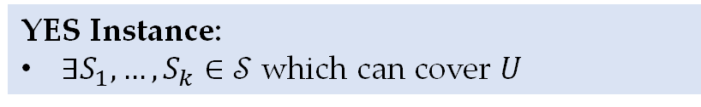



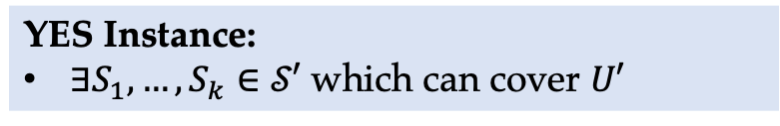
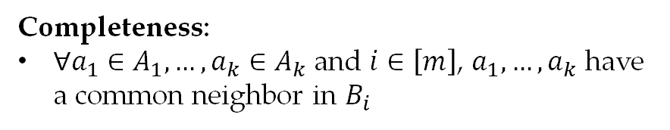
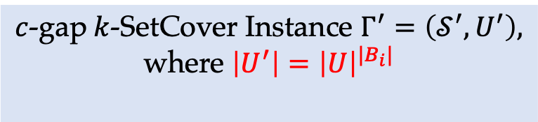
Threshold Graph Composition in [Lin19]
$k$-SetCover Instance $Γ=(𝒮,U)$
YES Instance:
$∃S_{1},…,S_{k}∈𝒮$ which can cover $U$
NO Instance:
any covering of $U$ has size $≥k+1$
$c$-gap$k$-SetCover Instance $Γ^{′}=\left(𝒮^{′},U^{′}\right),$
where $\left|U^{′}\right|={\left|U\right|}^{|B_{i}|}$
Threshold Graph $G_{T}=(A∪B,E)$
YES Instance:
$∃S_{1},…,S_{k}∈𝒮′$ which can cover $U′$
Completeness:
$∀a_{1}∈A_{1},…,a_{k}∈A_{k}$ and $i∈\left[m\right]$, $a_{1},…,a_{k}$ have a common neighbor in $B_{i}$
NO Instance:
any covering of $U$ has size $≥h$
Soundness:
$∀X⊆A$: If $∀i∈[m]$, $∃b_{i}∈B_{i}$ such that $b_{i}$ has $k+1$ neighbors in $X$, then $\left|X\right|>h$
Notes:
Ok, the limitation of [Lin19] is that, after composition, the universe size in the new instance is |U|^|B_i|, where U is the original instance size, B_i is the size of each right part in the threshold graph, which is closely related to how large h we can get. Therefore, this scheme only makes sense when |U| is small, e.g., starting from W[1] with |U|=poly(k)log n. If we start from W[2], |U| could be as large as the instance size n, thus |B_i| can only be made constant, which cannot give us any non-trivial threshold properties.

Slide 30
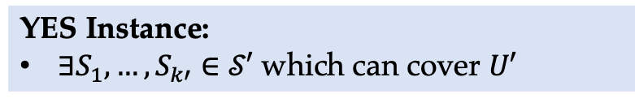
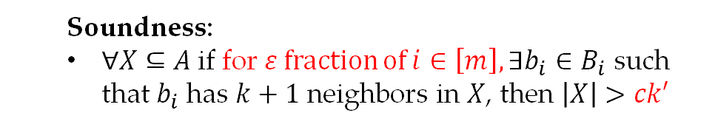
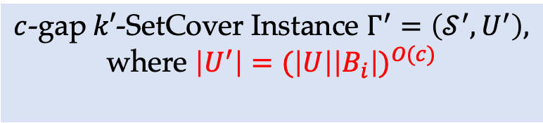
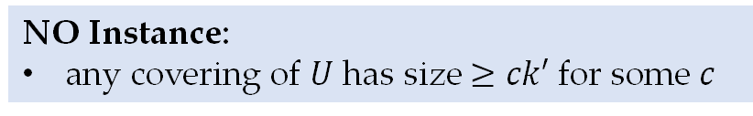
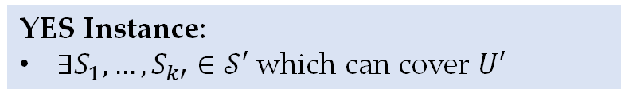

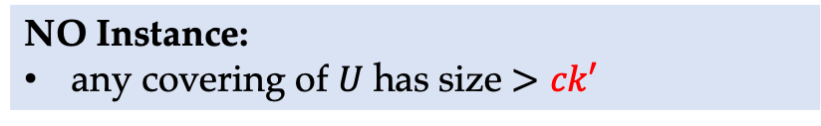
Threshold Graph Composition
$k$-SetCover Instance $Γ=(𝒮,U)$
YES Instance:
$∃S_{1},…,S_{k}∈𝒮$ which can cover $U$
NO Instance:
any covering of $U$ has size $≥k+1$
$c$-gap$k′$-SetCover Instance $Γ^{′}=\left(𝒮^{′},U^{′}\right),$
where $\left|U^{′}\right|={(\left|U\right|\left|B_{i}\right|)}^{O(c)}$
$c$-gap$k′$-SetCover Instance $Γ′=(𝒮′,U′)$
YES Instance:
$∃S_{1},…,S_{k′}∈𝒮′$ which can cover $U′$
YES Instance:
$∃S_{1},…,S_{k′}∈𝒮′$ which can cover $U′$
Threshold Graph $G_{T}=(A∪B,E)$
NO Instance:
any covering of $U$ has size $≥ck′$ for some $c$
Completeness:
$∀a_{1}∈A_{1},…,a_{k}∈A_{k}$ and $i∈\left[m\right]$, $a_{1},…,a_{k}$ have a common neighbor in $B_{i}$
NO Instance:
any covering of $U$ has size $>ck′$
Soundness:
$∀X⊆A$if for $ε$ fraction of $i∈\left[m\right], ∃b_{i}∈B_{i}$ such that $b_{i}$ has $k+1$ neighbors in $X$, then $\left|X\right|>ck′$
Notes:
With our modification of the threshold graph and our new composition scheme, now the new universe size would be (|U|*|B_i|)^{O(c)} where c is the gap. Taking c as a constant, we can get desired inapproximability while making the new instance size polynomial in n.

Slide 31

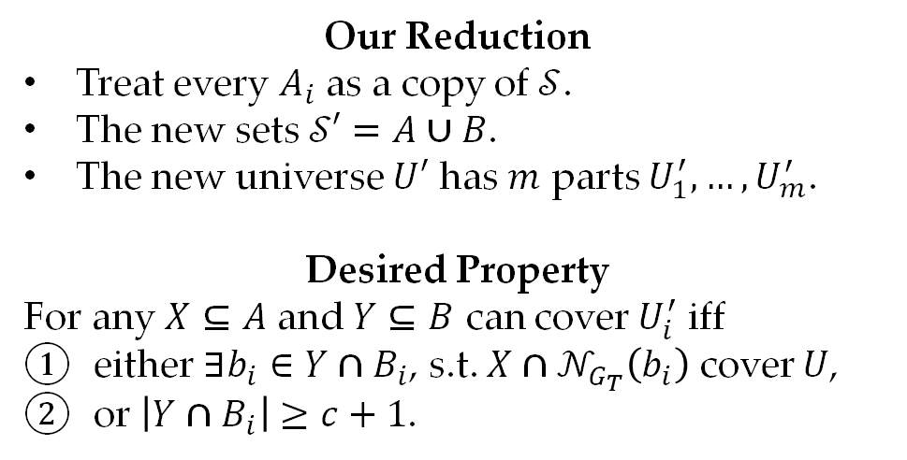
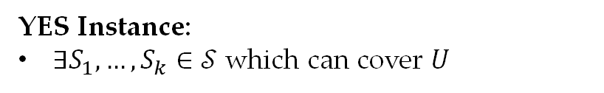

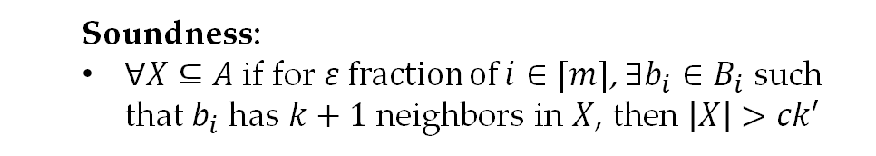
Threshold Graph Composition
Our Reduction
Treat every $A_{i}$ as a copy of $𝒮$.
The new sets $𝒮′=A∪B$.
The new universe $U′$ has $m$ parts $U_{1}^{′},…,U_{m}^{′}$.
Desired Property
For any $X⊆A$ and $Y⊆B$ can cover $U_{i}^{′}$ iff
either $∃b_{i}∈Y∩B_{i}$, s.t. ${X∩𝒩}_{G_{T}}\left(b_{i}\right)$ cover $U$,
or $\left|Y∩B_{i}\right|≥c+1$.
$k$-SetCover Instance $Γ=(𝒮,U)$
YES Instance:
$∃S_{1},…,S_{k}∈𝒮$ which can cover $U$
NO Instance:
any covering of $U$ has size $≥k+1$
Threshold Graph $G_{T}=(A∪B,E)$
Completeness:
$∀a_{1}∈A_{1},…,a_{k}∈A_{k}$ and $i∈\left[m\right]$, $a_{1},…,a_{k}$ have a common neighbor in $B_{i}$
Soundness:
$∀X⊆A$if for $ε$ fraction of $i∈[m]$, $∃b_{i}∈B_{i}$ such that $b_{i}$ has $k+1$ neighbors in $X$, then $\left|X\right|>ck′$
Notes:
Let me briefly introduce our reduction and give some analysis. Given a k-SetCover instance and a threshold graph, we treat every Ai as a copy of S, and let the new sets be the union of A and B. The new universe is divided into m parts. We want to make sure in order to cover the i-th part of the universe, either there exists a vertex in Bi, such that its picked neighbors in the threshold graph form a valid covering of U, or we pick at least c+1 vertices in Bi.

Slide 32
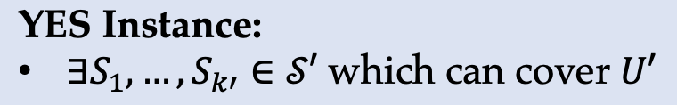
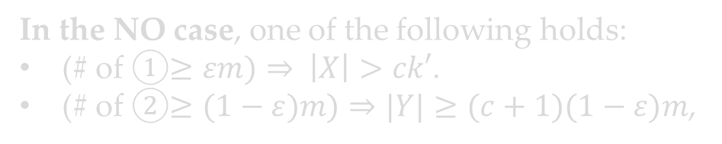
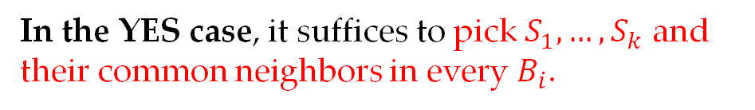
Analysis of the YES Case
Our Reduction
Treat every $A_{i}$ as a copy of $𝒮$.
The new sets $𝒮′=A∪B$.
The new universe $U′$ has $m$ parts $U_{1}^{′},…,U_{m}^{′}$.
Desired Property
For any $X⊆A$ and $Y⊆B$ can cover $U_{i}^{′}$ iff
either $∃b_{i}∈Y∩B_{i}$, s.t. ${X∩𝒩}_{G_{T}}\left(b_{i}\right)$ cover $U$,
or $\left|Y∩B_{i}\right|≥c+1$.
$k$-SetCover Instance $Γ=(𝒮,U)$
YES Instance:
$∃S_{1},…,S_{k}∈𝒮$ which can cover $U$
NO Instance:
any covering of $U$ has size $≥k+1$
Threshold Graph $G_{T}=(A∪B,E)$
Completeness:
$∀a_{1}∈A_{1},…,a_{k}∈A_{k}$ and $i∈\left[m\right]$, $a_{1},…,a_{k}$ have a common neighbor in $B_{i}$
In the YES case, it suffices to pick $S_{1},…,S_{k}$ and their common neighbors in every $B_{i}$.
Soundness:
$∀X⊆A$if for $ε$ fraction of $i∈[m]$, $∃b_{i}∈B_{i}$ such that $b_{i}$ has $k+1$ neighbors in $X$, then $\left|X\right|>ck′$
In the NO case, one of the following holds:
(# of ①$≥εm)⇒ \left|X\right|>ck′$.
(# of ②$≥(1−ε)m)⇒|Y|≥(c+1)(1−ε)m$,
Notes:
In the Yes case, there is a solution of size k in the original instance, so it suffices to pick them, together with their common neighbors in each Bi. This way, every part of the universe would satisfy condition 1.

Slide 33
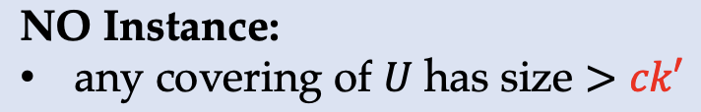
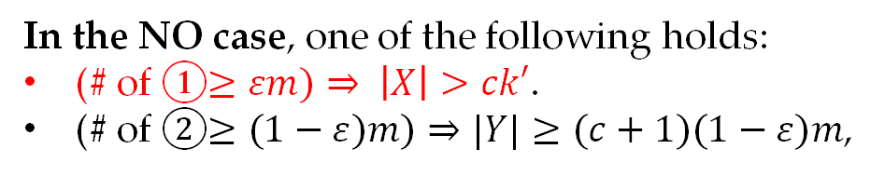
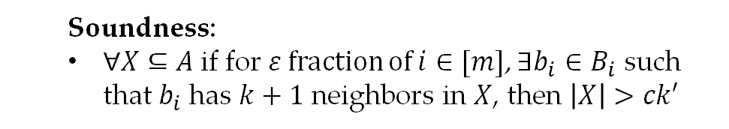
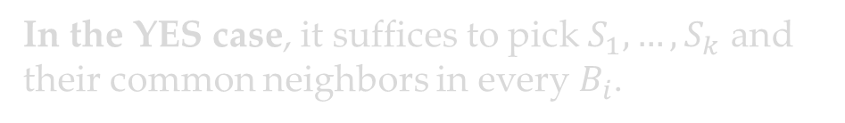
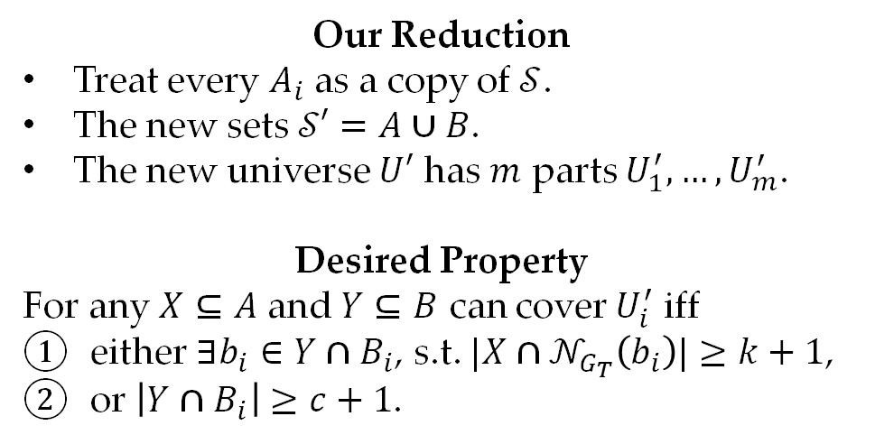
Analysis of the NO case
Our Reduction
Treat every $A_{i}$ as a copy of $𝒮$.
The new sets $𝒮′=A∪B$.
The new universe $U′$ has $m$ parts $U_{1}^{′},…,U_{m}^{′}$.
Desired Property
For any $X⊆A$ and $Y⊆B$ can cover $U_{i}^{′}$ iff
either $∃b_{i}∈Y∩B_{i}$, s.t. ${|X∩𝒩}_{G_{T}}\left(b_{i}\right)|≥k+1$,
or $\left|Y∩B_{i}\right|≥c+1$.
$k$-SetCover Instance $Γ=(𝒮,U)$
YES Instance:
$∃S_{1},…,S_{k}∈𝒮$ which can cover $U$
NO Instance:
any covering of $U$ has size $≥k+1$
Threshold Graph $G_{T}=(A∪B,E)$
Completeness:
$∀a_{1}∈A_{1},…,a_{k}∈A_{k}$ and $i∈\left[m\right]$, $a_{1},…,a_{k}$ have a common neighbor in $B_{i}$
In the YES case, it suffices to pick $S_{1},…,S_{k}$ and their common neighbors in every $B_{i}$.
Soundness:
$∀X⊆A$if for $ε$ fraction of $i∈[m]$, $∃b_{i}∈B_{i}$ such that $b_{i}$ has $k+1$ neighbors in $X$, then $\left|X\right|>ck′$
In the NO case, one of the following holds:
(# of ①$≥εm)⇒ \left|X\right|>ck′$.
(# of ②$≥(1−ε)m)⇒|Y|≥(c+1)(1−ε)m$,
Notes:
In the No case, one of the following must hold depending on how many parts satisfy condition 1. If the number is at least eps*m, we can deduce from the soundness property of the threshold graph that, the size of X is greater than c*k'.

Slide 34
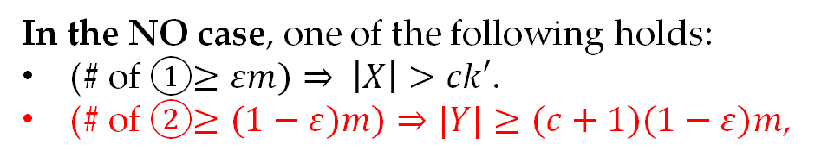
Analysis of the NO case
Our Reduction
Treat every $A_{i}$ as a copy of $𝒮$.
The new sets $𝒮′=A∪B$.
The new universe $U′$ has $m$ parts $U_{1}^{′},…,U_{m}^{′}$.
Desired Property
For any $X⊆A$ and $Y⊆B$ can cover $U_{i}^{′}$ iff
either $∃b_{i}∈Y∩B_{i}$, s.t. ${|X∩𝒩}_{G_{T}}\left(b_{i}\right)|≥k+1$,
or $\left|Y∩B_{i}\right|≥c+1$.
$k$-SetCover Instance $Γ=(𝒮,U)$
YES Instance:
$∃S_{1},…,S_{k}∈𝒮$ which can cover $U$
NO Instance:
any covering of $U$ has size $≥k+1$
Threshold Graph $G_{T}=(A∪B,E)$
Completeness:
$∀a_{1}∈A_{1},…,a_{k}∈A_{k}$ and $i∈\left[m\right]$, $a_{1},…,a_{k}$ have a common neighbor in $B_{i}$
In the YES case, it suffices to pick $S_{1},…,S_{k}$ and their common neighbors in every $B_{i}$.
Soundness:
$∀X⊆A$if for $ε$ fraction of $i∈[m]$, $∃b_{i}∈B_{i}$ such that $b_{i}$ has $k+1$ neighbors in $X$, then $\left|X\right|>ck′$
In the NO case, one of the following holds:
(# of ①$≥εm)⇒ \left|X\right|>ck′$.
(# of ②$≥(1−ε)m)⇒|Y|≥(c+1)(1−ε)m$,
Notes:
Otherwise the number of parts satisfying condition 2 must be at least (1-eps)*m, which means the size of Y is at least (c+1)*(1-eps)*m. By appropriately adjusting weights of A and B, we can get our desired inapproximability, while keeping the whole reduction running in polynomial time.

Slide 35
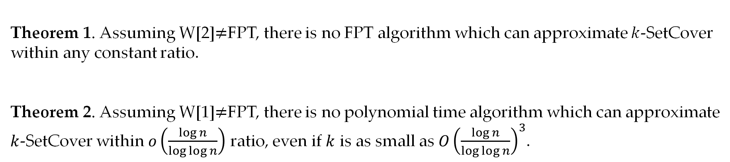
Summary
Theorem 1. Assuming W[2]$≠$FPT, there is no FPT algorithm which can approximate $k$-SetCover within any constant ratio.
Theorem 2. Assuming W[1]$≠$FPT, there is no polynomial time algorithm which can approximate $k$-SetCover within $o\left(\frac{\log{n}}{\log{\log{n}}}\right)$ ratio, even if $k$ is as small as $O{\left(\frac{\log{n}}{\log{\log{n}}}\right)}^{3}$.
Notes:
The contribution of this work can be summarized in the following two theorems. The first is the W[2]-hardness of constant approximating k-SetCover, the second is a combinatorial proof for hardness of approximating non-parameterized SetCover with almost optimal ratio and relatively small optimal solution size.

Slide 36

Open Questions
Open Question 1: Is it W[2]-hard to approximate $k$-SetCover within $ω(1)$ ratio?
Our reduction has running time ${Ω(|U|}^{c})$, thus can not get super-constant inapproximability.
Open Question 2: Is there any FPT algorithm which can approximate $k$-SetCover with approximation ratio $o(\log{n})$?
Current best lower bound is ${\left(\log{n}\right)}^{ε(k)}$ for any function $ε\left(k\right)=o(1)$.
Notes:
There are two main open questions.
The first is, can we lift our W[2]-inapproximability ratio to any super-constant? Our current reduction has running time |U|^c, thus is not FPT if c is super-constant.
The second question is that, can we prove a hardness of approximation factor for k-SetCover, which only depends on n and is independent of k? Current best lower bound is (log n)^{eps(k)} for any small function eps.

Slide 37
Q&A
Thanks!
Notes:
That's all of my talk. Thanks for your watching! Questions are welcomed.

Slide 38
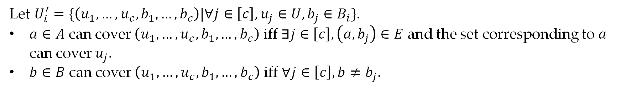
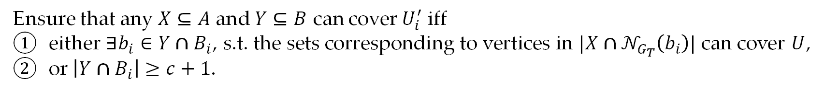
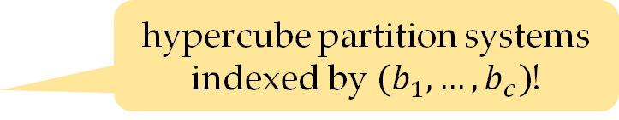
Threshold Graph Composition
Ensure that any $X⊆A$ and $Y⊆B$ can cover $U_{i}^{′}$ iff
either $∃b_{i}∈Y∩B_{i}$, s.t. the sets corresponding to vertices in ${|X∩𝒩}_{G_{T}}\left(b_{i}\right)|$ can cover $U$,
or $\left|Y∩B_{i}\right|≥c+1$.
hypercube partition systems indexed by $(b_{1},…,b_{c})$!
Let $U_{i}^{′}=\{\left(u_{1},…,u_{c},b_{1},…,b_{c}\right)|∀j∈\left[c\right],u_{j}∈U,b_{j}∈B_{i}\}$.
$a∈A$ can cover $\left(u_{1},…,u_{c},b_{1},…,b_{c}\right)$ iff $∃j∈\left[c\right], \left(a,b_{j}\right)∈E$ and the set corresponding to $a$ can cover $u_{j}$.
$b∈B$ can cover $\left(u_{1},…,u_{c},b_{1},…,b_{c}\right)$ iff $∀j∈\left[c\right], b≠b_{j}.$

Slide 39
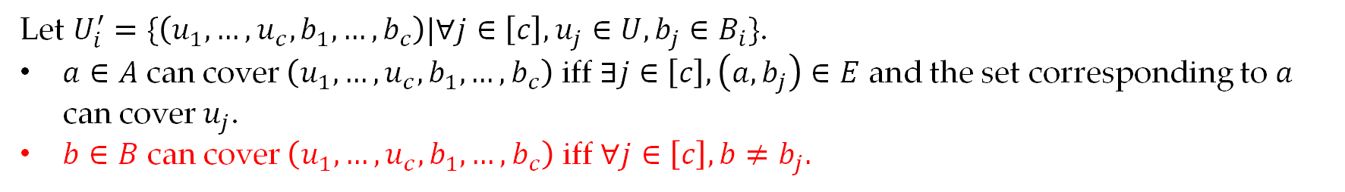
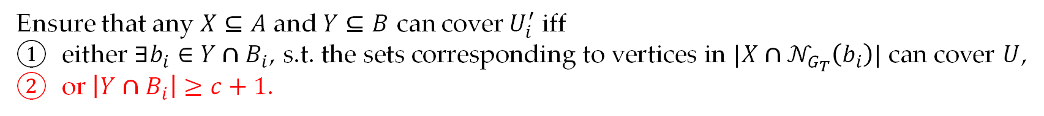
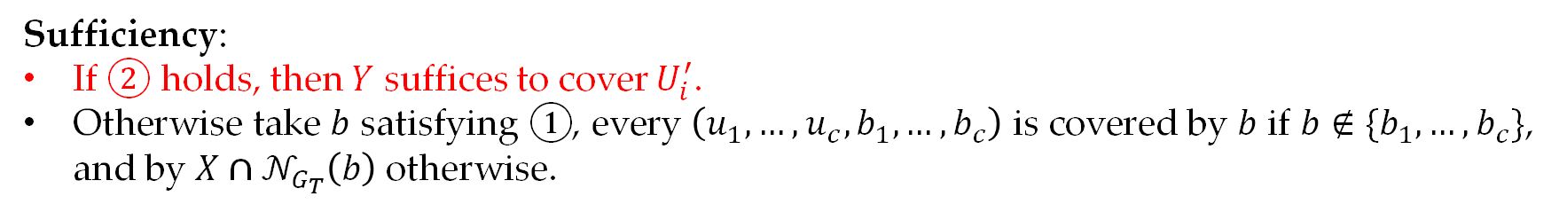
Threshold Graph Composition
Ensure that any $X⊆A$ and $Y⊆B$ can cover $U_{i}^{′}$ iff
either $∃b_{i}∈Y∩B_{i}$, s.t. the sets corresponding to vertices in ${|X∩𝒩}_{G_{T}}\left(b_{i}\right)|$ can cover $U$,
or $\left|Y∩B_{i}\right|≥c+1$.
hypercube partition systems indexed by $(b_{1},…,b_{c})$!
Let $U_{i}^{′}=\{\left(u_{1},…,u_{c},b_{1},…,b_{c}\right)|∀j∈\left[c\right],u_{j}∈U,b_{j}∈B_{i}\}$.
$a∈A$ can cover $\left(u_{1},…,u_{c},b_{1},…,b_{c}\right)$ iff $∃j∈\left[c\right], \left(a,b_{j}\right)∈E$ and the set corresponding to $a$ can cover $u_{j}$.
$b∈B$ can cover $\left(u_{1},…,u_{c},b_{1},…,b_{c}\right)$ iff $∀j∈\left[c\right], b≠b_{j}.$
Sufficiency:
If ② holds, then $Y$ suffices to cover $U_{i}^{′}$.
Otherwise take $b$ satisfying ①, every $\left(u_{1},…,u_{c},b_{1},…,b_{c}\right)$ is covered by $b$ if $b∉\{b_{1},…,b_{c}\}$, and by ${X∩𝒩}_{G_{T}}\left(b\right)$ otherwise.

Slide 40
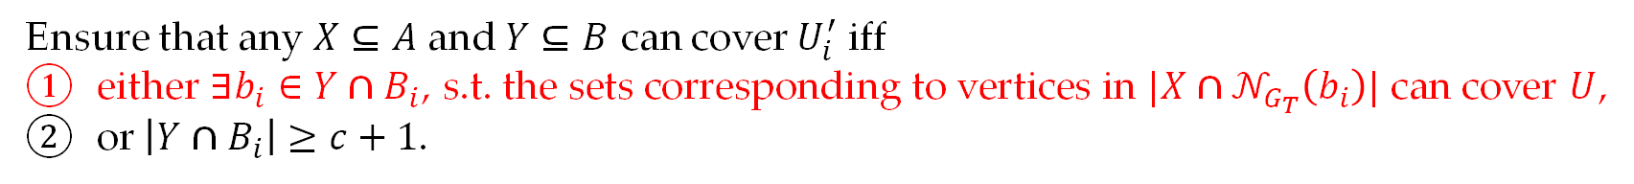
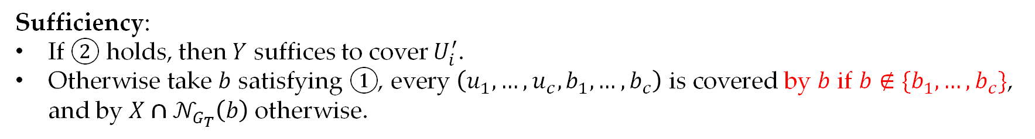
Threshold Graph Composition
Ensure that any $X⊆A$ and $Y⊆B$ can cover $U_{i}^{′}$ iff
either $∃b_{i}∈Y∩B_{i}$, s.t. the sets corresponding to vertices in ${|X∩𝒩}_{G_{T}}\left(b_{i}\right)|$ can cover $U$,
or $\left|Y∩B_{i}\right|≥c+1$.
hypercube partition systems indexed by $(b_{1},…,b_{c})$!
Let $U_{i}^{′}=\{\left(u_{1},…,u_{c},b_{1},…,b_{c}\right)|∀j∈\left[c\right],u_{j}∈U,b_{j}∈B_{i}\}$.
$a∈A$ can cover $\left(u_{1},…,u_{c},b_{1},…,b_{c}\right)$ iff $∃j∈\left[c\right], \left(a,b_{j}\right)∈E$ and the set corresponding to $a$ can cover $u_{j}$.
$b∈B$ can cover $\left(u_{1},…,u_{c},b_{1},…,b_{c}\right)$ iff $∀j∈\left[c\right], b≠b_{j}.$
Sufficiency:
If ② holds, then $Y$ suffices to cover $U_{i}^{′}$.
Otherwise take $b$ satisfying ①, every $\left(u_{1},…,u_{c},b_{1},…,b_{c}\right)$ is covered by $b$ if $b∉\{b_{1},…,b_{c}\}$, and by ${X∩𝒩}_{G_{T}}\left(b\right)$ otherwise.

Slide 41


Threshold Graph Composition
Ensure that any $X⊆A$ and $Y⊆B$ can cover $U_{i}^{′}$ iff
either $∃b_{i}∈Y∩B_{i}$, s.t. the sets corresponding to vertices in ${|X∩𝒩}_{G_{T}}\left(b_{i}\right)|$ can cover $U$,
or $\left|Y∩B_{i}\right|≥c+1$.
hypercube partition systems indexed by $(b_{1},…,b_{c})$!
Let $U_{i}^{′}=\{\left(u_{1},…,u_{c},b_{1},…,b_{c}\right)|∀j∈\left[c\right],u_{j}∈U,b_{j}∈B_{i}\}$.
$a∈A$ can cover $\left(u_{1},…,u_{c},b_{1},…,b_{c}\right)$ iff $∃j∈\left[c\right], \left(a,b_{j}\right)∈E$ and the set corresponding to $a$ can cover $u_{j}$.
$b∈B$ can cover $\left(u_{1},…,u_{c},b_{1},…,b_{c}\right)$ iff $∀j∈\left[c\right], b≠b_{j}.$
Sufficiency:
If ② holds, then $Y$ suffices to cover $U_{i}^{′}$.
Otherwise take $b$ satisfying ①, every $\left(u_{1},…,u_{c},b_{1},…,b_{c}\right)$ is covered by $b$ if $b∉\{b_{1},…,b_{c}\}$, and by ${X∩𝒩}_{G_{T}}\left(b\right)$ otherwise.

Slide 42

Threshold Graph Composition
Ensure that any $X⊆A$ and $Y⊆B$ can cover $U_{i}^{′}$ iff
either $∃b_{i}∈Y∩B_{i}$, s.t. the sets corresponding to vertices in ${|X∩𝒩}_{G_{T}}\left(b_{i}\right)|$ can cover $U$,
or $\left|Y∩B_{i}\right|≥c+1$.
hypercube partition systems indexed by $(b_{1},…,b_{c})$!
Let $U_{i}^{′}=\{\left(u_{1},…,u_{c},b_{1},…,b_{c}\right)|∀j∈\left[c\right],u_{j}∈U,b_{j}∈B_{i}\}$.
$a∈A$ can cover $\left(u_{1},…,u_{c},b_{1},…,b_{c}\right)$ iff $∃j∈\left[c\right], \left(a,b_{j}\right)∈E$ and the set corresponding to $a$ can cover $u_{j}$.
$b∈B$ can cover $\left(u_{1},…,u_{c},b_{1},…,b_{c}\right)$ iff $∀j∈\left[c\right], b≠b_{j}.$
Necessity:
If ② not satisfied (i.e., $\left|Y∩B_{i}\right|≤c$), let $Y∩B_{i}=\{{\hat{b}}_{1},…,{\hat{b}}_{c}\}$ (repetition allowed), elements in the system $(⋆,{\hat{b}}_{1},…,{\hat{b}}_{c})$ can only be covered by $X⊆A$. Moreover, it must be possible to cover only using the neighbor of some ${\hat{b}}_{j}$.

Slide 43

Threshold Graph Composition
Ensure that any $X⊆A$ and $Y⊆B$ can cover $U_{i}^{′}$ iff
either $∃b_{i}∈Y∩B_{i}$, s.t. the sets corresponding to vertices in ${|X∩𝒩}_{G_{T}}\left(b_{i}\right)|$ can cover $U$,
or $\left|Y∩B_{i}\right|≥c+1$.
hypercube partition systems indexed by $(b_{1},…,b_{c})$!
Let $U_{i}^{′}=\{\left(u_{1},…,u_{c},b_{1},…,b_{c}\right)|∀j∈\left[c\right],u_{j}∈U,b_{j}∈B_{i}\}$.
$a∈A$ can cover $\left(u_{1},…,u_{c},b_{1},…,b_{c}\right)$ iff $∃j∈\left[c\right], \left(a,b_{j}\right)∈E$ and the set corresponding to $a$ can cover $u_{j}$.
$b∈B$ can cover $\left(u_{1},…,u_{c},b_{1},…,b_{c}\right)$ iff $∀j∈\left[c\right], b≠b_{j}.$
Necessity:
If ② not satisfied (i.e., $\left|Y∩B_{i}\right|≤c$), let $Y∩B_{i}=\{{\hat{b}}_{1},…,{\hat{b}}_{c}\}$ (repetition allowed), elements in the system $(⋆,{\hat{b}}_{1},…,{\hat{b}}_{c})$ can only be covered by $X⊆A$. Moreover, it must be possible to cover only using the neighbor of some ${\hat{b}}_{j}$.

Slide 44



Threshold Graph from Error Correcting Codes
Proposed by [KN21]
Let $C:Σ^{r}→Σ^{m}$ be an error correcting code with relative distance $δ∈(0,1)$, we can construct a threshold graph as follows.
$∀i∈\left[k\right], A_{i}=\{C\left(x\right):x∈Σ^{r}\}$
$∀j∈\left[m\right],B_{j}=Σ^{k}$
$a∈A_{i}$ and $b∈B_{j}$ are linked iff ${\left(a\right)}_{j}={\left(b\right)}_{i}$
Example: $C=\left\{abcd, bcda,cdab\right\}$
“cdac”$∈B_{3}$ is a common neighbor of
“abcd”$∈A_{1},$“bcda”$∈A_{2},$“cdab”$∈A_{3}$ and “abcd”$∈A_{4}$.
$m$ columns
a | b | c | d
b | c | d | a
c | d | a | b
a | b | c | d
$k$ rows

Slide 45



Threshold Graph from Error Correcting Codes
Threshold properties:
(Completeness) $∀a_{1}∈A_{1},…,a_{k}∈A_{k}$ and $i∈\left[m\right]$, $a_{1},…,a_{k}$ have a common neighbor in $B_{i}$
(Soundness) $∀X⊆A$ and $I⊆\left[m\right]$ with $\left|I\right|≥εm$, if $∀i∈I∃b_{i}∈B_{i}$ such that $b_{i}$ has $k+1$ neighbors in $X$, then $\left|X\right|>h$
$b_{i}$ has $k+1$ neighbors
$⇒$ There must be two vertices in $X$ which are from the same block $j∈[m]$.
$⇒$ The $j$-th character of the two codewords must be same
However we know that for any two different codewords,
the distance between them is at least $δm$.
By a double counting argument, we can get $h≥\sqrt{\frac{2ε}{1−δ}}$.
$m$ columns
a | b | c | d
b | c | d | a
c | d | a | b
a | b | c | d
$k$ rows

